Slide 1
OBJECT RECOGNITION
----The Third Eye

Slide 2

What is Object Recognition ?
Object recognition is a process for identifying a specific object in a digital image or video. Object recognition algorithms rely on matching, learning, or pattern recognition algorithms using appearance-based or feature-based techniques.

Slide 3
ABSTRACT :
In this innovation lab project, we will try to identify the various objects present in our locality. We plan to build an interface which will recognize the object/objects from the image which will be provided to the system.

Slide 4
AIMS AND OBJECTIVE :
To detect the object present in the image by using methods like edge or corner detection.
To generate related information about the objects which are identified in images.
To add features like recognizing the text in the images

Slide 5
CURRENT STATUS:
Many approaches to the task have been implemented so far like face detection, barcode detection etc. Various Softwares have been developed to implement object recognition but they still lag in time efficiency. Moreover, Object Detection is still new in the market and a lot of research is still going on to improve the Object Detection(OD).

Slide 6
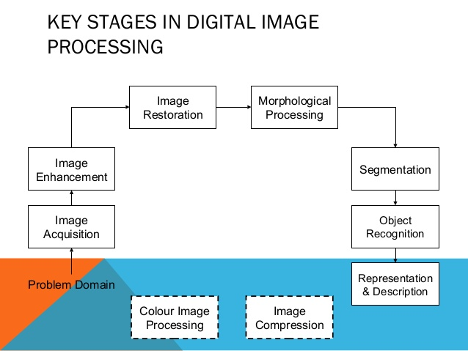

Slide 7

NOVELTY :
This project will ease or optimize the process of object recognition to some extent.This can also be extended to fields like the smart-education system, security purpose, object tracking.

Slide 8
TIME FRAME:
PHASE - 1:
The main focus of the first phase is to lay the groundwork for the project. We aim to develop an interface(Android App) which will have several basic functionalities: user-friendly interface, details of the object being recognized. We plan to do this in the time frame of 1 month.

Slide 9
PHASE - 2:
This phase involves taking the first step towards object recognition. In this phase, we plan to do a very basic thing, that is to identify colors from the pictures. We also plan to incorporate this developed feature into the app in this phase itself. The expected time for this phase is 14-21 days.

Slide 10
PHASE - 3:
We will take forward the idea developed in the previous phase to the next level, i.e, recognize an object . We will try to make the system able to detect and recognize a number of objects. For this, we start with the electrical components eg. resistors, transistors, as it will help amateurs to identify these components. Thus, we can extend this to a great number of objects. We expect to complete this whole phase by the end of the semester.

Slide 11
PHASE - 4
(ADD ON Phase):
(If time permits) We plan to add object recognition through real-time video analysis. Also, we plan to add extraction of text from the pictures.

Slide 12
What We Need to Learn ?
1. JAVA
2. ANDROID DEVELOPMENT
3. MATLAB
4. GIT

Slide 13
TEAM MEMBERS :
Sahil Sharma (1501CS40)
Rijul Dhir (1501CS37)
Ayush Mishra (1501CS16)

Slide 14
THANK - YOU…...

